Slide 1
Mudanças Climáticas/ Adaptação
Jerry W. Webb, P.E., D.WRE
Engenheiro Hidrólogo e Hidráulico Principal
Lider de Comunidade de Prática de Hidrologia, Hidráulica e Costeira
US Army Corps of Engineers, Headquarters
Jerry.w.webb@usace.army.mil
Oficina de Segurança de Barragens
Brasília, Brasil
20-24 Maio 2013

Slide 2
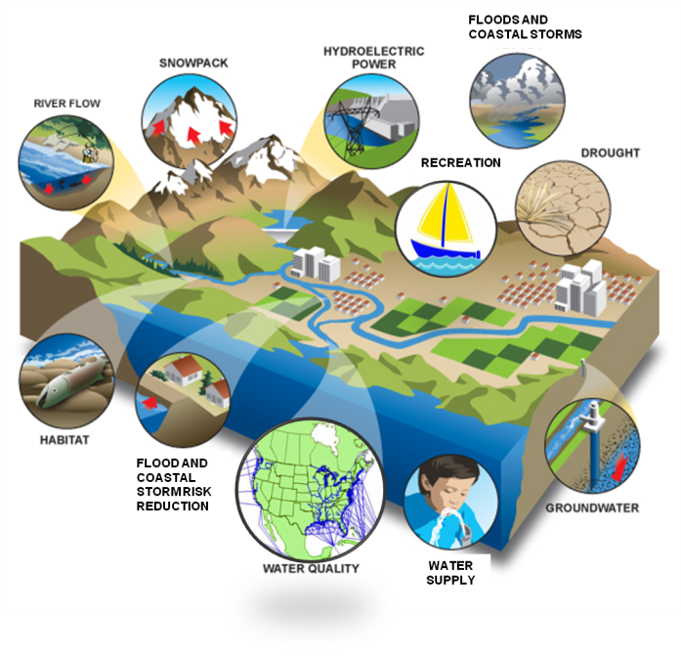
Missão do US Army Corps of Engineers: Gestão de Recursos Hídricos
Hidreletricidade
Gerenciamento de emergências
Restauração de ecossistemas
Recreação
Redução de riscos de inundações e tempestades costeiras
Regulação
Abastecimento de água
Navegação
NAVIGATION
Notes:
Esta apresentação é baseada na minha experiência de trabalho com o Army Corps of Engineers dos EUA (USACE) em como incorporar novas informações e mudança em nossas missões e operações.
O USACE tem cerca de 34 mil pessoas que apoiam missões militares e civis. Vou falar sobre o programa de obras civis, que tem cerca de 24 mil funcionários e um orçamento operacional de cerca de US $ 5 bilhões, que podem ser complementados para apoiar a resposta de emergência e operações de recuperação, tais como aqueles que foram associados com a grande enchente e inundação do meio-Oeste americano de 2011 e atualmente, furacão Sandy.
Nosso Civil Works missões de apoio à navegação, inundação e tempestade costeira redução de riscos, restauração de ecossistemas, energia hidrelétrica, recreação, regulamentar, abastecimento de água e gestão de emergência.

Slide 3
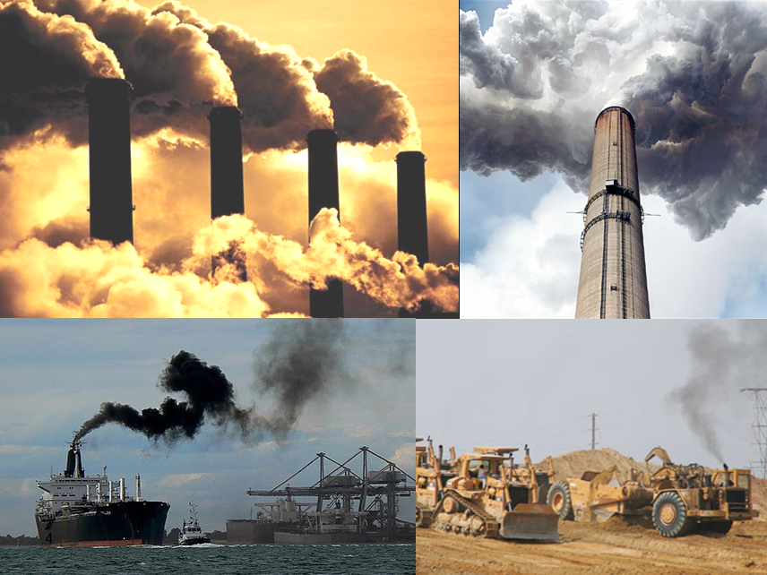
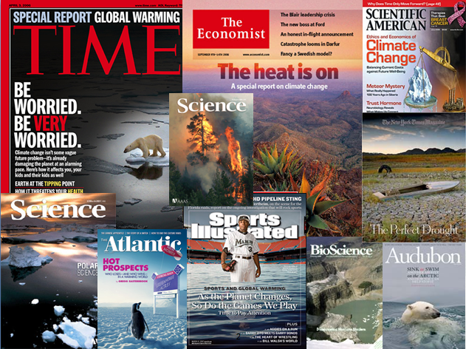
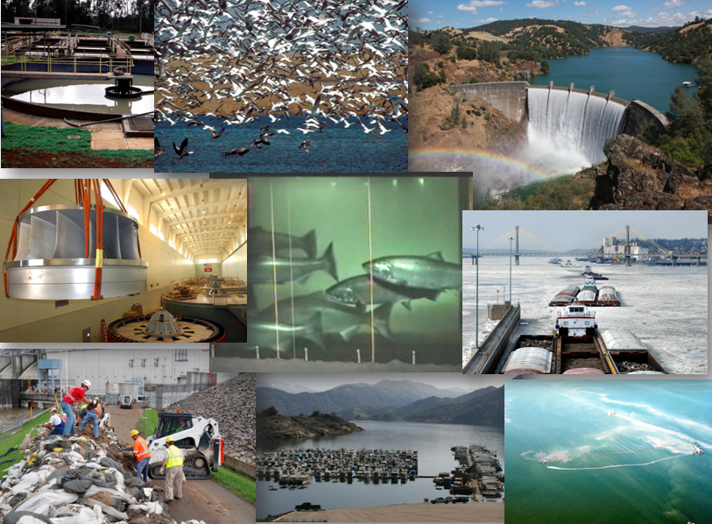
CarbonO
Mitigação das Mudanças Climáticas significa
Adaptação às mudanças climáticas significa
ÁGUA
Notes:
We know climate is changing and that Mudanças Climáticas principally affects temperature, precipitation and Tempestade intensity and frequency.
In simple terms, Mudanças Climáticas mitigation is about CARBON. USACE has an active sustainability and energy program to conserve energy and water and reduce greenhouse gas emissions (mitigation activities) in accordance with EO 13514. [Source: adapted from NOAA NCDC & USGCRP, 2009]
On the other hand, Mudanças Climáticas adaptation is about WATER, to put it simply. This is because Mudanças Climáticas can directly affect the hydrologic cycle and, through it, the quantity and quality of water resources. Mudanças Climáticas can lower minimum flows in rivers, affecting water availability and quality for drinking water, aquatic resources, energy production (hydropower), industrial manufacturing, thermal-electric plant cooling, and navigation. Mudanças Climáticas can also directly affect demand for water, when demand for crops increases in certain seasons, for instance.
And because we are a water resources management agency, we are already seeing changes, especially in snow-dominated watersheds, glaciers, Arctic ice covers, and permafrost areas. We may suspect some other changes are occurring, but don’t yet have enough definitive information to attribute these changes to Mudanças Climáticas.
What we don’t know is how fast climate is changing, how these changes will manifest themselves, and whether some changes are irreversible. But we do know that the steps we take to adapt to Mudanças Climáticas also help us adapt to other challenges to our missions and operations, because they share a common goal: to improve resilience and decrease vulnerability.

Slide 4
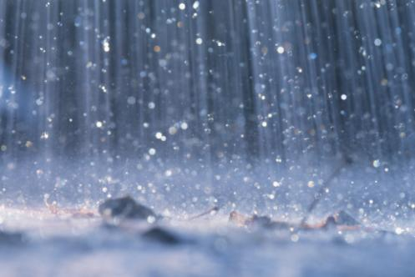
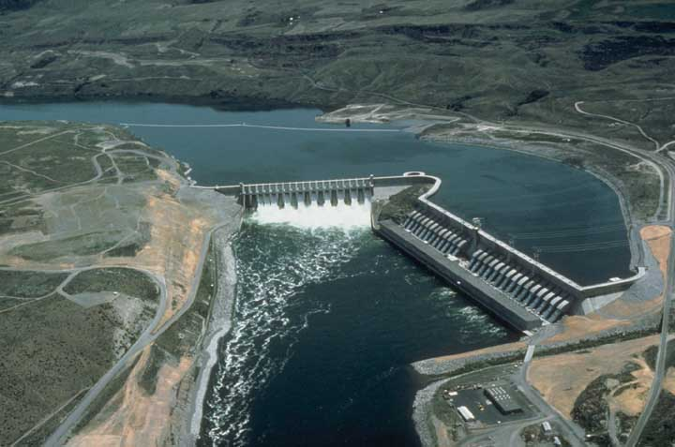
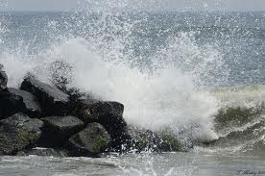
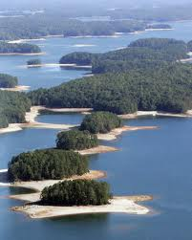
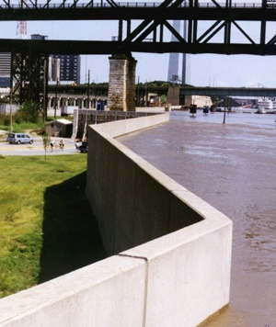

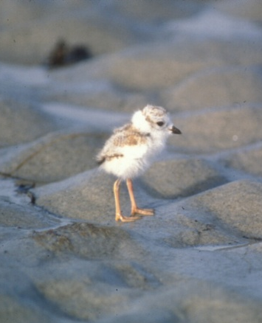
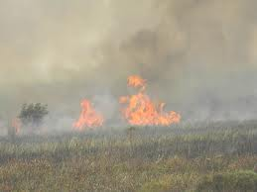
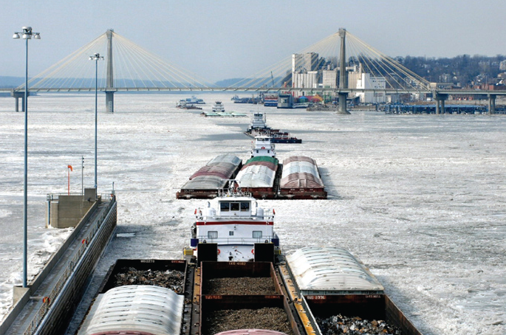
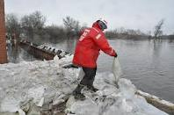
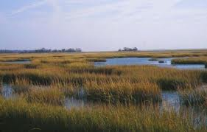
A Missão do USACE em Adaptação às Mudanças Climáticas :
Aumentar a resiliência e diminuir a vulnerabilidade aos efeitos das Mudanças e Variabilidade Climáticas
Bill Byrne, MA F&W
Notes:
The Responses to Mudanças Climáticas Program supports the USACE Adaptação às Mudanças Climáticas mission to improve resilience and decrease vulnerability to the effects of Mudanças Climáticas and variability.
We believe that the scope, collaboration, and resources applied to Mudanças Climáticas adaptation planning, demonstrate the importance USACE has placed on this critical challenge to the long-term sustainability of our mission, operations, programs and projects that oversee and administer public water resources and associated infrastructure in every state, as well as several international Bacias, and support military operations worldwide that promote peace and stability.
There are many definitions of resilience – but essentially for USACE, improving resilience means that we can successfully perform our missions, operations, programs, and projects despite the challenges of global and Mudanças Climáticas, and that we have the capacity for positive adaptation with no significant change to structure or function.
****************************************************************************
Resilience – Amount of change a system can undergo without changing state. (IPCC, TAR, 2001)
Resilience – Resilience is a tendency to maintain integrity when subject to disturbance. (UNDP, 2005)
Resilience – The ability of a system to recover from the effect of an extreme load that may have caused harm. (UKCIP, 2003)
Resilience – The capacity of a system, community or society potentially exposed to hazards to adapt, by resisting or changing in order to reach and maintain an acceptable level of functioning and structure. This is determined by the degree to which the social system is capable of organizing itself to increase its capacity for learning from past disasters for better future protection and to improve risk reduction measures. (UN/ISDR, 2004)

Slide 5
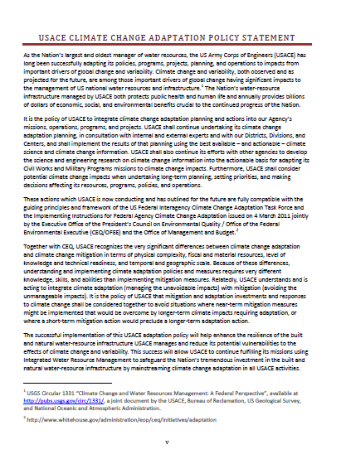
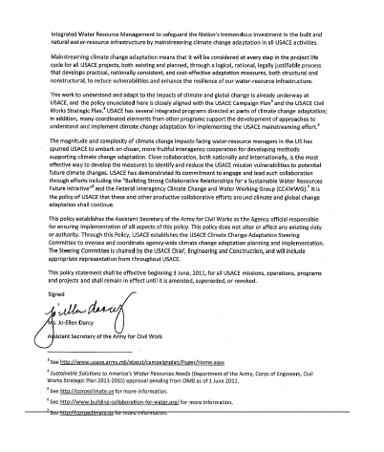
Política do USACE de Adaptação às Mudanças Climáticas - Junho de 2011
Integrar o planejamento e ações de adaptação às Mudanças Climáticas dentro da missão, operação e projetos do USACE
Usar a melhor ciência do clima que esteja mais disponível e possa ser implementada, bem como informações sobre Mudanças Climáticas, em nível apropriado de análise.
Considerar os impactos das Mudanças Climáticas no planejamento a longo-prazo, na priorização e tomada de decisões
http://www.corpsclimate.us/adaptationpolicy.cfm
Notes:
In June 2011, the Assistant Secretary of the Army for Civil Works, Ms. Jo-Ellen Darcy, signed the USACE Mudanças Climáticas Adaptation Policy Statement.
The policy statement signed by Ms. Darcy calls for integrating Mudanças Climáticas adaptation into all that we do. The statement notes that Mudanças Climáticas and variability, both observed and as projected for the future, are among those important drivers of global change having significant impacts to the management of US national water resources and infrastructure.
It also points out that we should do this now based on the best available and actionable science – and plenty of information is available – and that we should consider Mudanças Climáticas impacts as we plan for the future. We are developing methods that will support an appropriate level of analysis for the decision being made.
This policy establishes the Assistant Secretary of the Army for Civil Works as the Agency official responsible for ensuring implementation of all aspects of this policy.
Through this Policy, USACE establishes the USACE Mudanças Climáticas Adaptation Steering Committee to oversee and coordinate agency-wide Mudanças Climáticas adaptation planning and implementation. The Steering Committee is chaired by the USACE Chief, Engineering and Construction, and the first meeting is tomorrow.

Slide 6
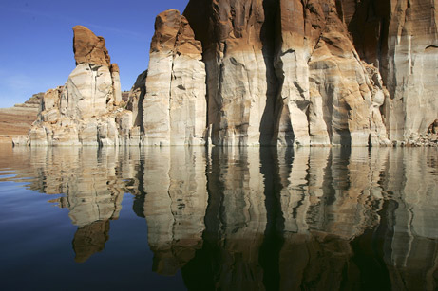
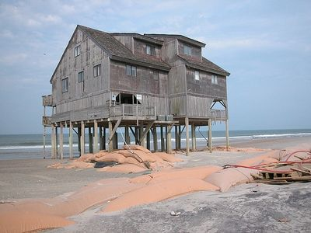
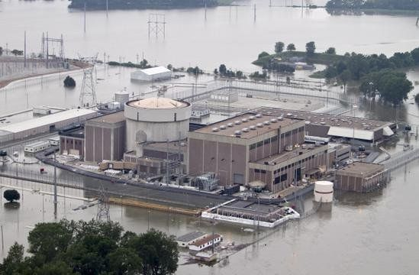
Mudanças Climáticas, Eventos Extremos e Infraestutura de Recursos Hídricos
Eventos extremos e aumento da variabilidade climática aumentam a vulnerabilidade dos recursos hídricos
  Saúde pública e segurança
  Desenvolvimento econômico
  Sustentabilidade ambiental
National Geographic
Notes:
Two factors of water resources management are especially important to note:
First – Mudanças Climáticas, Eventos extremos, and increasing variability increase the vulnerability of water resources infrastructure, and
Second, the long lifetime of Infraestrutura de Recursos Hídricoshas additional implications we need to consider in the context of Eventos extremos.
Our own experience shows us that Mudanças Climáticas and variability – especially Eventos extremos – are increasingly important considerations for water infrastructure.
This is because Mudanças Climáticas and variability directly affects the hydrologic cycle and, through it, the quantity and quality of water resources. Mudanças Climáticas can lower minimum flows in rivers, affecting water availability and quality for drinking water, aquatic resources, energy production (hydropower and thermoelectric generation), industrial manufacturing, navigation, and recreation. These impact all of us in three major ways: Saúde pública and segurança, Desenvolvimento econômico, and Sustentabilidade ambiental
And because we are a water resources management agency, we are already seeing changes, especially in snow-dominated watersheds, glaciers, Arctic ice covers, and permafrost areas. For example, we know that sea-levels are changing and that geological processes can exacerbate the changes. We know that changes in the onset and volume of snowmelt are impacting water management for Inundaçãos and Seca in the Sierra Nevada Mountains and the Pacific Northwest. We may suspect some other changes are occurring, but don’t yet have enough definitive information to attribute these changes to Mudanças Climáticas.
There are a few characteristics of both Mudanças Climáticas and water resources that we need to bear in mind as we approach adaptation.
Shown here: impacts to North Carolina coastline, Seca on the Colorado River, and 2011 Inundaçãoing along the Missouri River impacting electrical generation at a nuclear facility

Slide 7
Extremos e Surpresas Aumentam a Complexidade
“… o maior problema não é quando falhamos em prever os eventos que podem ser surpreendentes.”
“e, sim, quando falhamos em decidir em quais eventos devemos agir, e com que intensidade tomar estas medidas.”
“ Esta falha resulta, no mínimo parcialmente, do fato de que não houve implementação de um mecanismo sistemático …. Para ajudar a decidir em quais eventos devemos agir de forma mais agressiva, em quais de forma mais branda, e quais devemos ignorar, por enquanto.”
US DoD Defense Science Board: Capability Surprises
Notes:
Not only are we dealing with a wicked problem, but Mudanças Climáticas impacts to Infraestrutura de Recursos Hídricosis about surprises, some known (e.g., global sea levels are rising) and some unknown (how will atmospheric carbon levels outside the observed range manifest themselves at the local level?).
It’s these surprises and their potentially very disruptive consequences that water resources managers are concerned with.
I think as engineers, we are certainly familiar envisioning plausible futures, and we may already have engineering solutions that can deal with these. So in part, we have the “how.”
The bigger problem facing us, and society as a whole, is: which changes do we act on, and when?
For the most part, we do not have a systematic method, an overarching policy, and a socioeconomic or political mechanism in place to help us know which are the urgent needs and which can wait. So in effect, we’re forced to take the wicked problems approach.
The relationship between water infrastructure and large scale social stability helps to maintain the health of stable cultures that support Desenvolvimento econômico and ecologic sustainability.
But we can’t afford to be reactive to every surprise climate brings us, nor can we afford to be proactive about every potential future condition.
On the other hand, we need to be able to discern when an investment in being proactive pays off. It is in answer to this question that science moves into policy and then action.
*****
Known and unknown surprises and how to manage them was a topic of the 2008 DSB Summer Study: Capability Surprise (Volume I: http://www.acq.osd.mil/dsb/reports/ADA506396.pdf and Volume II: http://www.acq.osd.mil/dsb/reports/ADA506396.pdf) . DSB pointed out in Vol. 1 that “In both cases, the biggest issue is not a failure to envision events that may be surprising. It is a failure to decide which ones to act upon, and to what degree. That failure results, at least partially, from the fact that there is no systematic mechanism in place within DoD or the interagency to help decide which events to act upon aggressively, which to treat to a lesser degree, and which to ignore, for the time being.”
In the Appendix to the Main volume, DSB said: “Wicked problems will characterize more and more of DoD’s future challenges… The interdependencies, complexities and non-linear behavior of the modern world require something beyond the traditional approaches that were effective in a simpler time.”
“Policymakers benefit when they can take into account what the analysts see as the full range of possible outcomes on a tough issue . . . analysts should not usurp the decision role of policymakers by prematurely limiting the options on the table.” Davis, J. “The Challenge of Managing Uncertainty: Paul Wolfowitz on Intelligence Policy-Relations,” Studies in Intelligence, 1996 Unclassified Edition

Slide 8
Longa Vida Útil da Infraestrutura de Recursos Hídricos
Aumento da Severidade dos Impactos às Mudanças Climáticas
Engenharia e Projeto
Vida útil da Infraestrutura
Construção
Em operação
Planejamento
Infraestrutura planejada e construída baseada no clima e metereologia do passado podem não ser adequados para operação e resiliência futuras.
0 10 20 30 40 50 60 70 80 90 100
Anos
After United States Ports: Addressing the Adaptation Challenge, Mr. Mike Savonis
Notes:
The second factor is that Infraestrutura de Recursos Hídricosis often publicly funded and provides benefits to a population that can be spatially far removed from an actual project or system. Funding these projects involves intergovernmental collaboration, social and political partnering, and complicated financial leveraging.
These processes can impact the length of the planning process, in turn affecting engineering design and construction.
Thus for water resources infrastructure, we are looking at a long planning, engineering, and construction process. This, combined with the long lifetime of water resources infrastructure, means that we need to build flexibility to adapt to changing conditions, particularly Eventos extremos. As a result, building lead time for Adaptação às changing extremes is important.
One way to increase lead time is to consider a wide range of potential future conditions, especially extremes, and to identify triggers or thresholds at which adaptation decisions need to be made. This concept is incorporated in the adaptation guidance USACE is developing.

Slide 9
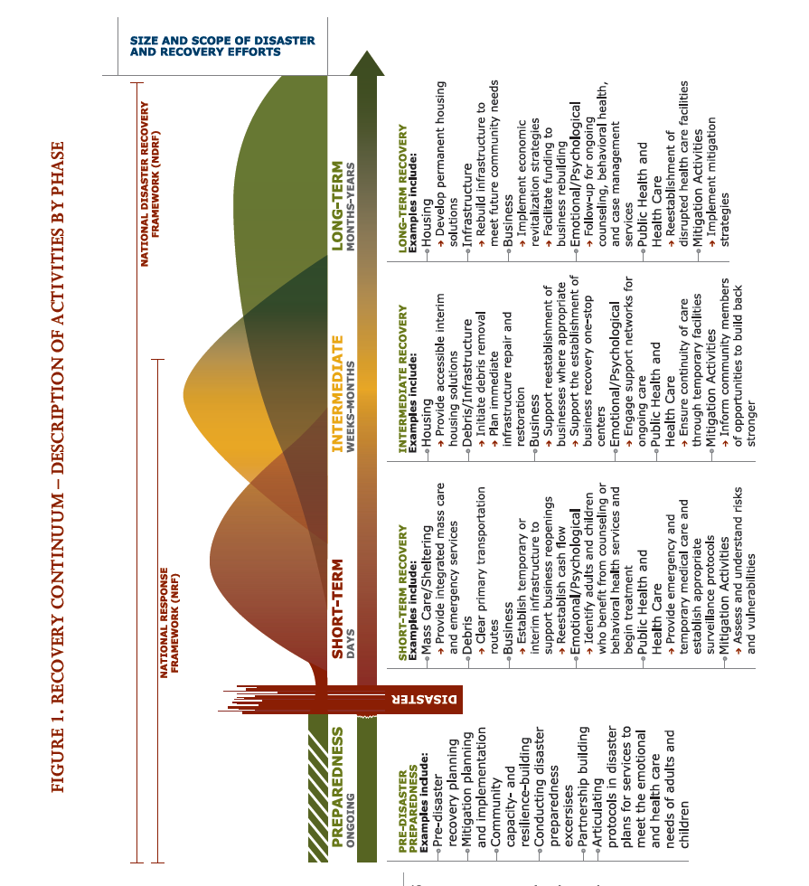
Adaptação às Mudanças Climáticas e Eventos Extremos é Contínua
Análise, Medidas Operacionais, Engenharia antecipatória
Políticas, Medidas Estruturais e Adaptação após-evento
Preparação, Resposta, Recuperação
DISASTER
Notes:
So we can consider Adaptação às Eventos extremos as a continuum from preparedness, response and recovery through to implementation of adaptation measures, whether operational or structural.

Slide 10
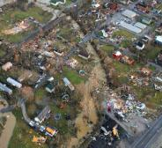
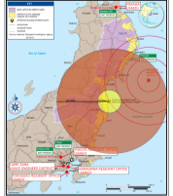
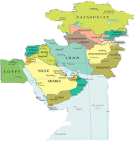
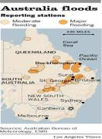
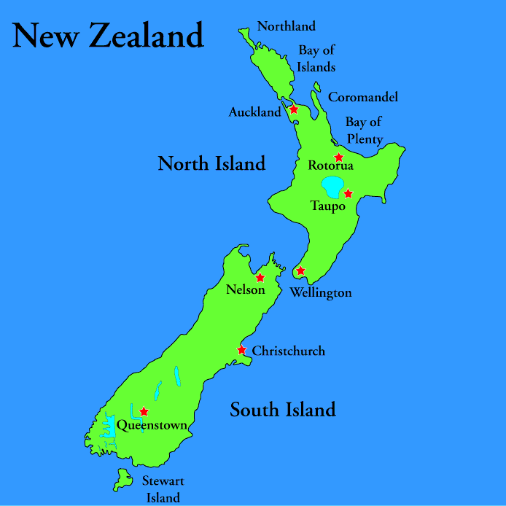

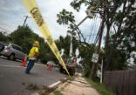
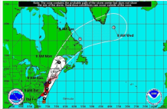
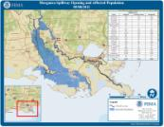
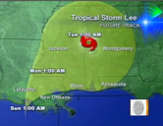
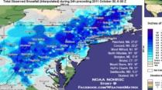
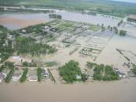
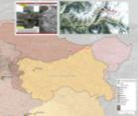
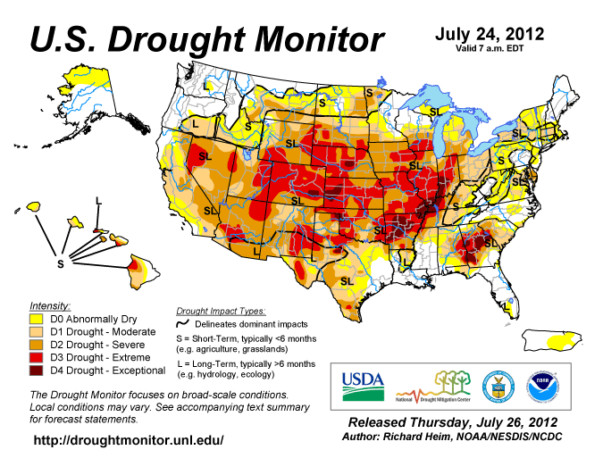
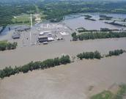
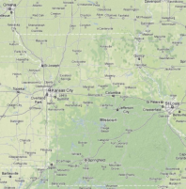
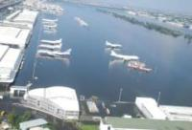
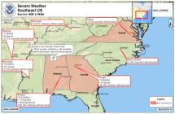
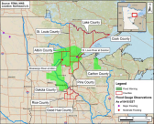

Respostas Principais 2011/2012
Condições metereológicas severas– Midwest
Mar 2012
Japaão terremoto e Tsunami - Mar 2011
FEST Deployments Jan – Mar 2011 & OEF/OND
Queensland, Australia Inundação - Jan 2011
Christchurch, New Zealand Terremoto - Feb 2011
Bacia Kootenai
2012
Tempestade de neve
Out 2011
Derecho Tempestades
JUN-JUL 12
Furacão Irene
Aug 2011
Tempestade Tropical Lee
Sep 2011
MS Inundaçãos
Maio 2011
Pakistan Siachen Geleira
Abril 2012
Rio Souris Inundação
Jun/Jul 2011
Joplin, MO
Tornado - Junho 2011
2012 Seca
Rio MO Inundação
Jun/Jul 2011
AL & MS Tornados
Abril 2011
RRCC VII
Duluth, MN Inundação
Joplin, MO (RFO)
Thailand Inundação - Nov 2011
Fort Crowder
Logistics Point
Notes:
But we also need to understand that where we have not yet adapted to extreme conditions through anticipatory engineering or adaptive measures, it is emergency preparedness, response, and recover that are the key factors in how successful we are in managing Eventos extremos.
Here are just some of the key emergency responses we’ve supported in 2011 and 2012.
So we can consider Adaptação às Eventos extremos as a continuum from preparedness, response and recovery through to implementation of adaptation measures, whether operational or structural.

Slide 11
Uma revisão rápida de como usar cenários no apoio à análise de Mudanças Climáticas com ênfase nas mudanças no nível do mar.

Slide 12
Mudança de paradigmas: De modelos de Equílibrio aos Modelos Dinâmicos
Furacão Katrina
  Revisões internas e externas após o Furacão Katrina (IPet, HPDC, ASCE, National Academies, e outros) demonstraram que precisamos incorporar condições novas e mutáveis​​, ambas previstas e imprevistas, em projetos e programas do USACE
Estacionariedade
  As Mudanças Climáticas desbancam a suposição básica, que historicamente tem facilitado a gestão do abastecimento e demanda de água e seus riscos.’ Milly et al 2008
Notes:
The USACE has undergone a paradigm shift from viewing the world primarily as one in which processes tended toward an equilibrium case, which would allow us to be prepared for the future if we could just describe it adequately, to one in which we now recognize that the world is dynamic and changing.
Our impetus to recognize this paradigm came from internal and external reviews following Furacão Katrina, and from the Mudanças Climáticas literature. One important paper by Milly et al is shown here: “ Estacionariedadeis Dead: Whither Water Management?” This paper asks, was stationary ever alive?
These the internal and external reviews of Furacão Katrina were a clear indication to us that we need to incorporate foreseen and surprise changes into our projects and programs. The IPET-HPDC Lessons Learned Implementation Team began working in 2006 to develop guidelines and recommend policy and program changes along with supporting technologies, to address dynamic processes, temporal and spatial changes, and their impacts to USACE projects on watershed, regional or system scale (e.g., subsidence, Mudanças Climáticas and variability, sea level change).
Reviews were provided by the Interagency Performance Evaluation Team (IPET, see https://ipet.wes.army.mil/), the Furacão Protection Decision Chronology (HPDC, see http://www.iwr.usace.army.mil/docs/hpdc/hpdc.cfm), the American Society of Civil Engineers (ASCE, see http://www.asce.org/uploadedFiles/Publications/ASCE_News/2009/04_April/ERPreport.pdf) and the National Academies (see http://www.nae.edu/Publications/Bridge/EngineeringfortheThreatofNaturalDisasters/LessonsfromFuracãoKatrina.aspx), among others.

Slide 13
Mudança fundamental na abordagem para analisar condições futuras
Historicamente, identificamos uma condição de futuro única mais provável e baseamos nossas análises sem projeto (marco zero) nesta condição
Agora, compreendemos que podem haver vários futuros plausíveis, cada um representando uma combinação diferente de processos físicos, valores sociais e políticos, e condições econômicas, entres outros fatores.
Em particular, na hidrologia, não podemos mais depender da premissa de estacionariedade, onde se supõe que as propriedades estatísticas de variáveis hidrológicas em períodos futuros serão similares ao passado (p.e. variações futuras ocorrem em mesmo intervalo que no passado).
Notes:
This changing paradigm brings with it the need to assess the future in different ways, particularly in the area of water resources management.
There are numerous ways to develop and describe future conditions.

Slide 14
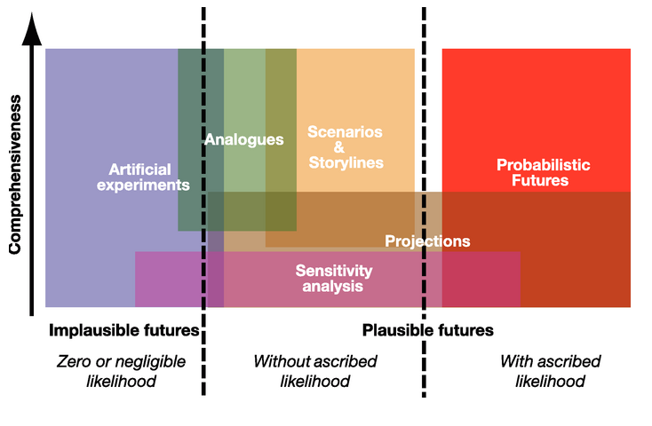
Universo de Futuros
Carter et al (2007)
Notes:
There is a whole universe of futures – our challenge is to select one or more methods that are appropriate for the decisions to be made, based on the potential consequences, the potential for long-term unintended consequences, and of course, our other decision-making processes.
As we conduct our evaluations and formulate management plans, we must be careful that we do not prematurely down-select to one future, in a way that reduces our ability to explore potential future conditions to manage risks.
Glossary (definitions from or based on Carter et al 2007 “General guidelines on the use of scenario data for climate impacts and adaptation assessment, version 2,June 2007:”
Scenario
A scenario is a coherent, internally consistent and plausible description of a possible future state of the world (IPCC, 1994).
It is not a forecast; rather, each scenario is one alternative image of how the future can unfold.
A projection may serve as the raw material for a scenario, but Cenários often require additional information (e.g., about baseline conditions).
A set of Cenários is often adopted to reflect, as well as possible, the range of uncertainty in projections. Other terms that have been used as synonyms for scenario are "characterisation", "storyline" and "construction".
Projection.
The term "projection" is used in two senses in the Mudanças Climáticas literature.
In general usage, a projection can be regarded as any description of the future and the pathway leading to it.
A more specific interpretation has been attached to the term "climate projection" by the IPCC when referring to model-derived estimates of future climate.
Forecast/Prediction.
When a projection is designated "most likely" it becomes a forecast or prediction.
A forecast is often obtained using physically-based models, possibly a set of these, outputs of which can enable some level of confidence to be attached to projections.

Slide 15
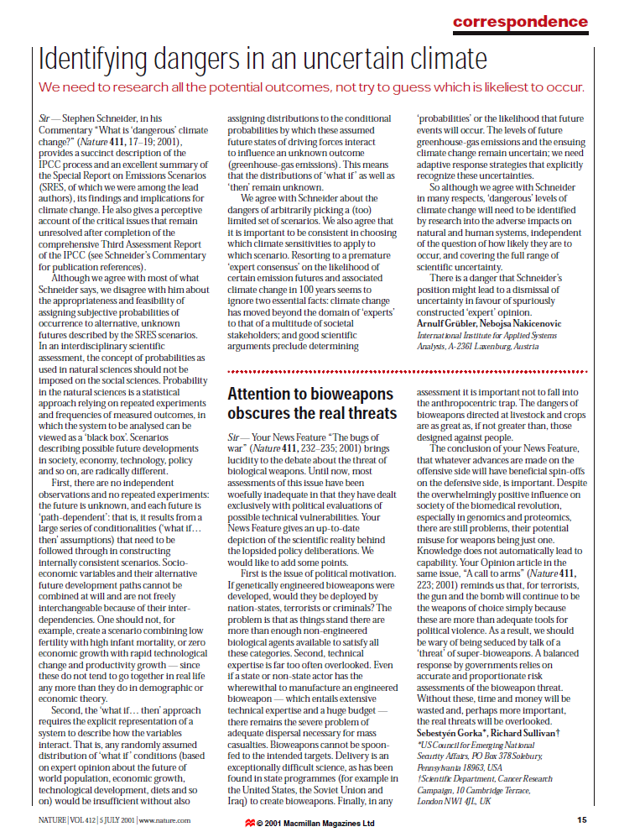
“Precisamos pesquisar todos os resultados possíveis, não tente adivinhar o que é mais provável de ocorrer.”
“Probabilidade, nas ciências naturais, é uma abordagem estatística com base em experiências e freqüências de resultados medidos, em que o sistema a ser analisado pode ser visto como uma "caixa preta”. Cenários que descrevem possíveis mudanças futuras na sociedade, economia, tecnologia, política, e assim por diante, são radicalmente diferentes.”

Slide 16
Por que cenários?
Cenários são apropriados quando as incertezas são grandes, as consequências são significativas, e os resultados não podem ser delineados
Cenários visam a esclarecer as possíveis vulnerabilidades naquele intervalo de resultados
Uma vez que identificamos como e onde somos vulneráveis​​, podemos avaliar se estamos preparados para lidar com estas vulnerabilidades
Em seguida, fazemos escolhas (trade-offs) entre os custos e outros efeitos de cada opção para lidar com as vulnerabilidades
Probabilidades simplificam a matemática, mas realmente não nos ajudam a explorar esses tipos de questões – ao contrário, as probabilidades facilitam ignorar estas questões
Notes:
In general, Cenários are appropriate when uncertainties are large, the consequences are significant, and outcomes cannot be bounded.
Sea level change (and more broadly, broader Mudanças Climáticas) meets the first and last of these three conditions. For the second condition, we use sensitivity testing to determine the potential consequence of sea-level change. That sensitivity test guides our scope of study and the rigor of the scenario analysis.

Slide 17
Por que cenários de mudanças no nível do mar - MNN?
Relembrando que cenários são utilizados quando as incertezas são grandes, as consequências são significativas, e os resultados não podem ser delineados
As MNM (e Mudanças Climáticas mais amplas) atendem à primeira e última das três condições acima.
Para a segunda condição acima, usamos testes de sensibilidade para determinar a consequência potencial da mudança do nível do mar, e o teste de sensibilidade orienta nosso escopo de estudo e o rigor da análise de cenários
Notes:
In general, Cenários are appropriate when uncertainties are large, the consequences are significant, and outcomes cannot be bounded.
Sea level change (and more broadly, broader Mudanças Climáticas) meets the first and last of these three conditions. For the second condition, we use sensitivity testing to determine the potential consequence of sea-level change. That sensitivity test guides our scope of study and the rigor of the scenario analysis.

Slide 18
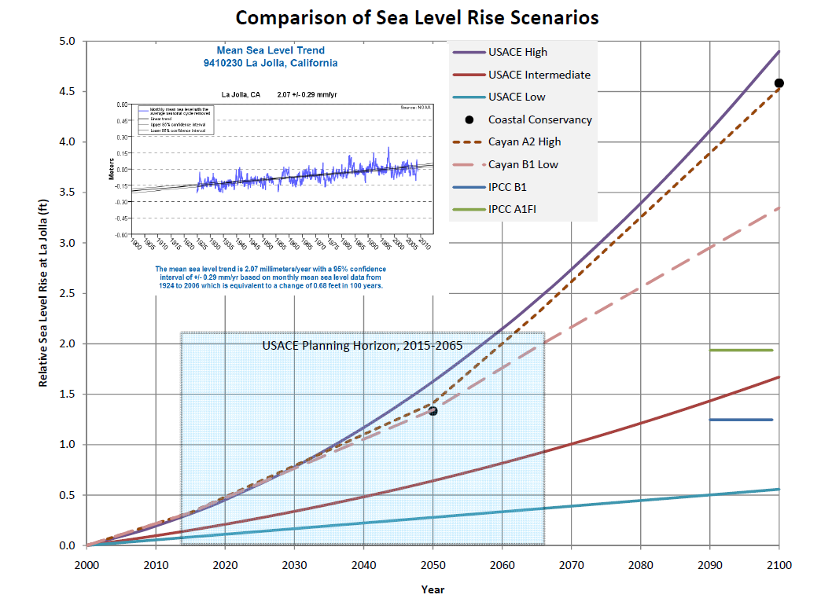
EC 1165-2-211 Incorporando Mudanças no Nível do Mar no âmbito de Programas de Construção Civil
Três estimativas de MNM futuras devem ser calculadas para todos os projetos de obras civis dentro da extensão da influência estimada das marés :
  Tendência extrapolada
  NRC Curva 1 Modificada
  NRC Curva 3 Modificada
Essas curvas são cenários baseados em diferentes hipóteses sobre os processos e causas, sem atribuições específicas de probabilidade
Como resultado, os Cenários utilizados na EC 1165-2-2011 ao lado representam múltiplos futuros plausíveis
Notes:
The lowest blue curve is the extrapolated historical trend, which is an extrapolation of the data shown in the inset box. This curve is primarily controlled by regional sea level change projection and land uplift or subsidence.
The red intermediate curve is the updated 1987 National Research Council (NRC) curve 1. The blue and green markers that bound this line indicate the 2007 IPCC SRES low and high estimates (SRES = special report on emissions Cenários, a subset of 6 of the IPCC projections). The IPCC in 2007 does not provide an analytical expression of sea-level change that allows us to develop a curve, but rather a single point in time in the future. The purple line provides the updated NRC curve 3.
We can also represent stakeholder Cenários or projections. For this location, the dotted lines on the graph show locally-generated estimates from Scripps Institution of Oceanography (Cayan). And the black dots denote Coastal Conservancy estimates.
The blue shaded box indicates the Corps’ typical planning horizon.
NOTE: According to the IPCC 2007 Synthesis for Policy Makers: "Because understanding of some important effects driving sea level rise is too limited, this report does not assess the likelihood, nor provide a best estimate or an upper bound for sea level rise. Table SPM.1 shows model-based projections of global average sea level rise for 2090-2099.[10] The projections do not include uncertainties in climate-carbon cycle feedbacks nor the full effects of changes in ice sheet flow, therefore the upper values of the ranges are not to be considered upper bounds for sea level rise. They include a contribution from increased Greenland and Antarctic ice flow at the rates observed for 1993-2003, but this could increase or decrease in the future.[11] {3.2.1}"
So IPCC did not assign likelihoods, nor did it intend to establish an upper bound for the projected 2099 levels.

Slide 19
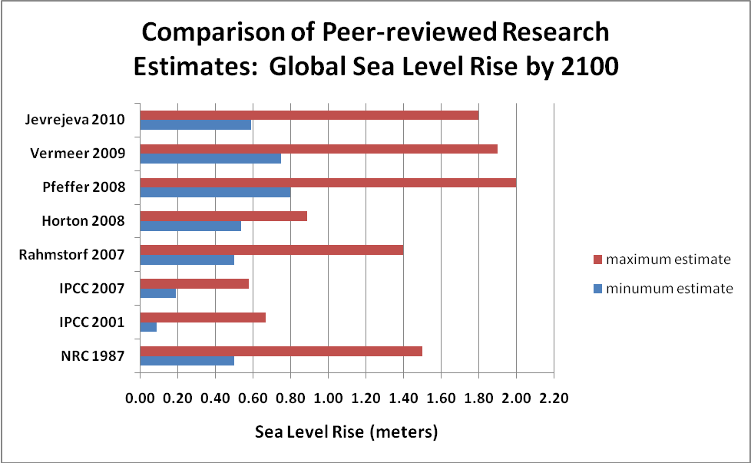
Comparação entre EC 1165-2-211, IPCC, e outras pesquisas recentes
Não incluem as mudanças no nível do mar resultantes das mudanças nas grandes placas de gelo cobrindo Greenland e Antartica.
~ EC
Notes:
The EC compares well with recent estimates. Again, as noted previously, "Because understanding of some important effects driving sea level rise is too limited, this report does not assess the likelihood, nor provide a best estimate or an upper bound for sea level rise.“
Recent research has used alternate approaches to explore further the issue of global sea-level change. Their results are presented above for the year 2100 (references are provided below).
The curves used in EC 1165-2-211 are comparable to the results of the recent research.
References:
NRC 1987. Responding to Changes in Sea Level, Engineering Implications, Committee on Engineering Implications of Changes in Relative Mean Sea Level, Marine Board, Commission on Engineering and Technical Systems, National Research Council. National Academy Press, Washington DC 1987, 148pp.
IPCC 2001. Mudanças Climáticas 2001: The Scientific Basis, edited by J.T. Houghton et al., Cambridge University Press, Cambridge, U.K.
IPCC 2007. Mudanças Climáticas 2007: The Physical Science basis. Contribution of Working Group I to the Fourth Assessment Report of the Intergovernmental Panel on Mudanças Climáticas, edited by S. Solomon et al., Cambridge University press, Cambridge U.K.
Rahmstorf, S. 2007. A semi-empirical approach to projecting future sea level rise, Science, 315, no. 5810, pp 368-370.
Horton, R., et al., 2008. Sea level rise projections for current generation CGCMs based on the semi-empirical method, Geophysical Research Letters, Vol. 35, L02715, 2008.
Pfeffer, W.T., et al., 2008. Kinematic constraints on glacier contributions to 21’st-century sea –level rise, Science, 321 , no. 5894, pp 1340-1343.
Vermeer, M., and S. Rahmstorf 2009. Global sea level linked to global temperature, Proceedings of the National Academy of Sciences, Early Edition, October 2009, 6pp.
Jevrejeva, S., et al., 2010. How will sea level respond to changes in natural and anthropogenic forcings by 2100?, Geophysical Research Letters, Vol. 37, L07703, 2010.

Slide 20
Exemplos de adaptação às Mudanças Climáticas

Slide 21
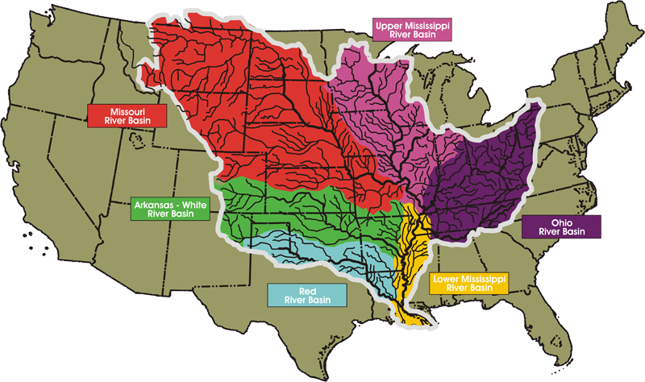
Exemplo: Eventos Extremos na Bacia do Mississippi
Alto Rio Mississippi e Rio
Missouri Combinados
Rio Ohio
Flow Contribution to Lower Mississippi River
Notes:
The Mississippi Valley
Theme: Overview of the Mississippi River Watershed
The basin covers more than 1,245,000 sq mi (3,220,000 km²), including all or parts of 32 U.S. states and two Canadian provinces.
The total watershed of the Mississippi River covers nearly 40% of the landmass of the continental United States.
Although only 29% of the watershed, the Ohio Valley, shown in dark purple, contributes 60% of the flow to the lower Mississippi, shown in yellow.
Mississippi Bacia is 1.25 million-square-miles (324 million hectares) in size.
It gathers water from 41% of the continental United States … which includes 31 states and 2 Canadian provinces.
It encompasses 3 Corps Divisions and the 3 largest rivers in the United States.
3rd largest watershed in the world behind the Amazon and Congo respectively.
Average flow = 640,000 cfs (18,100 cms)
2011 peak flow = 2.4 million cfs (68,000 cms)
Lower Mississippi Bacia = 35,000 sq. miles
Rhine Bacia = 86,870 square miles = 22.5 million hectares (about 1/14 of the Miss. Basin)
Avg Flow = 80,500 cfs (2,280 cms) or about 1/8 of the Miss.
Lower Rhine delta = 9,650 sq. miles ( 2.5 million hectares)
Current design flow = 530,000 cfs (15,000 cms)
Room for the River design flow = 565,000 cfs (16,000 cms)

Slide 22
Eventos Extremos no Rio Mississippi
A Inundação de 2011 testou o Sistema
  Volume imenso e prolongado, derretimento de neve e chuva
  O sistema funcionou conforme projetado
    Sistema de redução de risco de inundação operado na capacidade máxima, alguns componentes funcionaram pela primeira vez na história.
    O projeto demonstrou uma grande capacidade de prognóstico.
Seca de 2012 testou o sistema de novo
  Impactos na navegação, abastecimento de água, recreação, produção de energia
Nos anos 2011 e 2012, ressaltou-se a
resiliência aos eventos extremos
Notes:
In 1928, MG Edgar Jadwin, then Chief of Engineers, developed a plan to prevent disastrous Inundaçãos on the Lower Mississippi River.
Because they were dealing with short periods of record and large risks, the engineers who developed the Jadwin plan incorporated what we might today call relatively large uncertainty
In 2011, that plan proved its worth as USACE battled Inundaçãowaters similar to those of 1927.
In 2012, the system was tested by Eventos extremos, this time by Seca. Again, the system proved relatively resilient to this extreme.

Slide 23
Tratado do Rio Columbia 2014/2024
Estudos de Impactos às Mudanças Climáticas

Slide 24
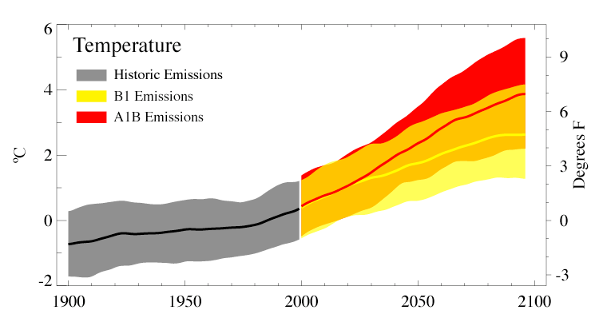
Aumentos projetados na Temperatura Anual
HH
2080s
+5.3ºF
(2.8-9.7ºF)
2040s
+3.2ºF
(1.6-5.2ºF)
2020s
+2.0ºF
(1.1-3.4ºF)
°C
°F
Escolha de cenários de emissão são mais importantes depois de 2040
* Comparado com a média de 1970-1999
Mote and Salathé, 2010
Notes:
24
Figure 1. Simulated temperature (change this slide) and precipitation (% change, next slide) for the 20th and 21st Century climate model simulations. The black curve for each panel is the weighted average of all models during the 20th Century. The colored areas indicate the range (5th to 95th percentile) for each year in the 21st Century. All changes are relative to 1970-1999 averages.

Slide 25
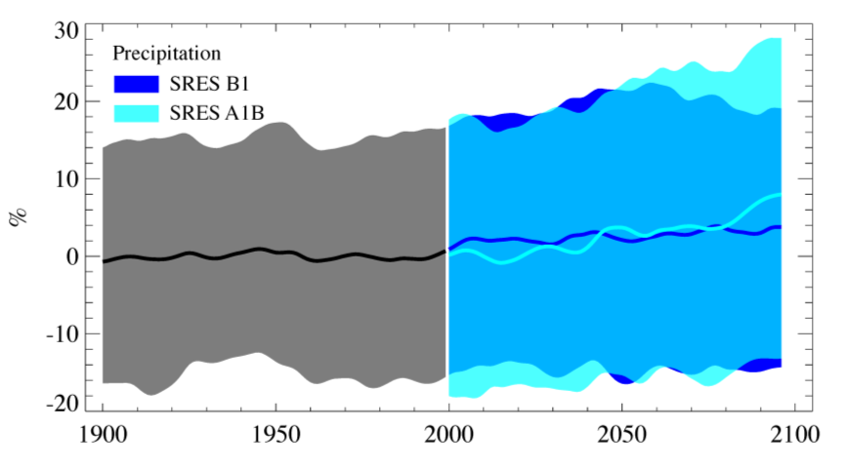
Mudanças projetadas na precipitação anual
HH
* Comparada com a média 1970-1999
As Mudanças na precipitação média anual foi pequena mas apresentaram grandes mudanças sazonais, especialmente no sentido de mais chuva/neve no outono e inverno, e verões mais secos.
Mote and Salathé, 2010
Notes:
25
Figure 2. Simulated temperature (change, previous slide) and precipitation (% change, bottom panel) for the 20th and 21st Century climate model simulations. The black curve for each panel is the weighted average of all models during the 20th Century. The colored areas indicate the range (5th to 95th percentile) for each year in the 21st Century. All changes are relative to 1970-1999 averages.
It is worth noting that, while a few % change in total precipitation may not seem important, the way the precipitation is delivered may change. If that precipitation comes as more Tempestades that are comparable to those in the historical record, then the implications are for more of the same kinds of Tempestades that we have observed and are already prepared for. If, however, that precipitation comes as more intense Tempestades that deliver more precipitation than the strorms with which we are familiar, the meaning changes completely for urban infrastructure and Inundação risk.

Slide 26
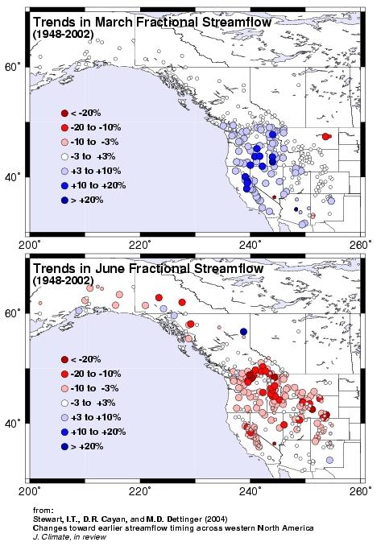
Tendencias na vazão fracional de rios
HH
Como o Oeste americano se aquece, a vazão aumenta na primavera e diminui no verão
Stewart IT, Cayan DR, Dettinger MD, 2005: Changes toward earlier streamflow timing across western North America, J. Climate, 18 (8): 1136-1155
Notes:
Spring snowmelt timing has advanced by 10-40 days in most of the West, leading to increasing flow in March (blue circles) and decreasing flow in June (red circles), especially in the Pacific Northwest.

Slide 27
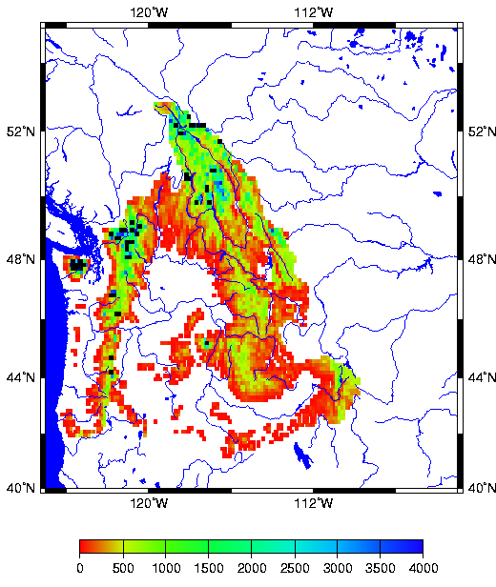
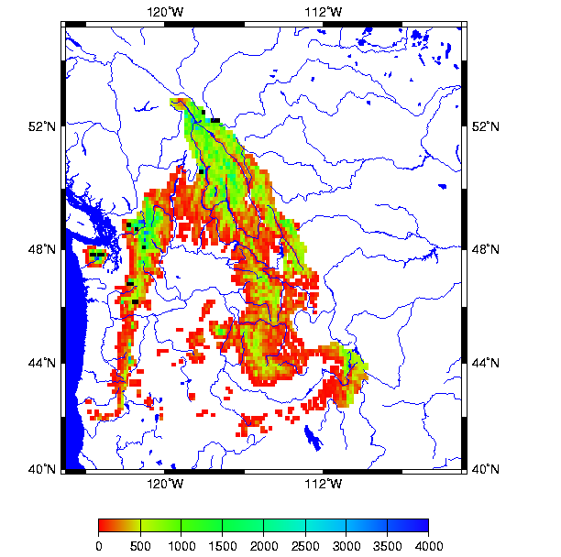
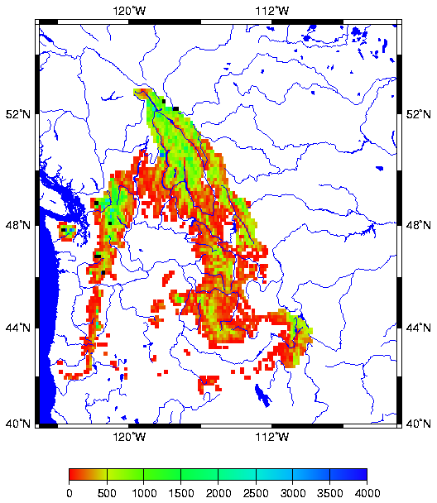
Mudanças no acúmulo de neve Simulada em 1º de abril
Bacia do rio Columbia no lado Canadense e dos EUA
(% de mudança relativa ao clima atual)
20th Century Climate
“2020s” (+1.7 C)
“2040s” (+ 2.25 C)
-3.6%
-11.5%
-21.4%
-34.8%
Abril 1 SWE (mm)

Slide 28
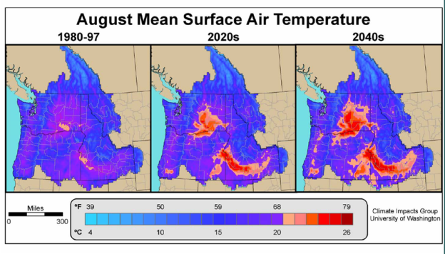
Limites de Temperatura para peixes de água fria em água doce
Temperaturas elevadas irão aumentar o estresse dos peixes de água fria nas regiões mais quentes.
  Uma média mensal da temperatura da água de 68ºF (20ºC) tem sido usada como limite superior para habitat dos peixes de águas frias, e sabe-se que esta temperatura estressa o Salmão do Pacífico durante a migração em água doce para a reprodução e desova.
+1.7 °C
+2.3 °C

Slide 29

O Dalles Regulado,
Ano Médio no Dalles
Úmido tem mais volume em Nov-Maio
Pico é um pouco mais cedo, mas similar.
Base tem volume mais aparente em Jul-Set

Slide 30
Vazão de saída HydSim Média no Dalles
Queda no começo de abril atribuída à redução das vazões laterais como definidas pelo Tratado
Observe um aumento significativo nas vazões de inverno
Observe vazões de verão reduzidas

Slide 31
Controle de Inundação versus Reenchimento
Equilíbrio entre proteção contra enchentes e confiabilidade de reenchimento é crucial na Bacia do Columbia.
Como as vazões de pico ocorrem cedo no ano.
  O cronograma de evacuação por inundação precisa ser revisado
    Para proteger contra a temporada de inundações precoces
    Para começar o enchimento mais cedo para capturar (pequenas) enchentes de primavera.
Experimentos-modelo (ver Payne et al. 2004) têm mostrado que ao deslocar-se duas semanas a um mês para mais cedo, a evacuação decorrente de enchentes ajuda a mitigar a redução do enchimento associada às mudanças do tempo de resposta das vazões.
Payne, J.T., A.W. Wood, A.F. Hamlet, R.N. Palmer, and D.P. Lettenmaier, 2004, Mitigating the effects of Mudanças Climáticas on the water resources of the Columbia Bacia, Climatic Change, Vol. 62, Issue 1-3, 233-256

Slide 32
Implicações para Acordos Transfronteiriços
O acúmulo de neve no Canadá é menos sensível ao aquecimento do que na porção americana da Bacia do Columbia.
  As mudanças no período de vazões do rio também serão pequenas no Canadá.
Dentro dos próximos 50 anos ou mais, o Canada terá uma fração de incremento de acúmulo de neve contribuindo para os volumes de vazão de verão na Bacia do Rio Columbia.
Estes impactos distintos entre os dois países tem o potencial de “desequilibrar” os acordos atuais de coordenação, e apresentará desafios sérios para manter as vazões a jusante no lado americano.
São necessárias mudanças no controle de cheias, produção de hidreletricidade e aumento de vazão de entrada...
Faz-se necessário planejamento a longo prazo para lidar com estas questões.

Slide 33
Outras implicações das Mudanças Climáticas

Slide 34


Bulletin 17B Revision
Redação anterior sobre “tendências climáticas:”
  “Há muita especulação sobre mudanças climáticas. A evidência disponível indica que grandes mudanças ocorrem em escalas de tempo que envolvem milhares de anos. Na análise hidrológica convencional, pressupõe-se que as vazões de enchentes não são afetadas por tendências ou ciclos climáticos. A invariância climática temporal foi assumida ao desenvolver este manual.”

Slide 35
Bulletin 17B Revision
Redação revisada para o parágafo de clima:
  “Há muita especulação sobre mudanças no risco de inundação ao longo do tempo. A evidência disponível indica que grandes mudanças podem estar ocorrendo ao longo de décadas ou séculos. Enquanto a invariância climática temporal foi assumida ao desenvolver este manual, onde se pode quantificar as mudanças climáticas e o risco de inundação ao longo do tempo com precisão, os impactos de tais mudanças devem ser incorporados na análise de frequências através do emprego de parâmetros LP3 de variância temporal ou usando outras técnicas apropriadas e estatisticamente justificadas. Todos esses métodos precisam ser cuidadosamente documentados e justificados.”

Slide 36

Implicações na segurança de barragens
Mudanças nos tipos e na magnitude das tempestades
Mudanças nas características do escoamento superficial
Mudanças no cálculo da Precipitação Máxima Provável – Alteração no Ponto de Orvalho

Slide 37

Exemplos dos efeitos das mudanças da precipitação regional
2050 A1FI Seca Index
Modelo AR4 do IPCC CCSM3
  Regiões ao Sul mais secas durante a época de produção agrícola, reduzindo a produtividade da agricultura.
  Tempestades extremas afetam a América Central e o Caribe mais do que outras regiões.
  Mudanças nas sazonalidades (secas/chuvas)
Mapa de Ganguly et al., (ORNL) produzida para apoiar o QRD 2009.
http://www.ornl.gov/knowledgediscovery/QDR/
--
Notes:
Precipitation Patterns and Seca
Secas, like fires, are often associated with warmer conditions. There are certainly cold deserts, such as those of the high Andes, and Secas (in the sense of reduced precipitation) can occur in the Southern Hemisphere (austral) winter. Winter Secas (reduced rain or snow) can have important consequences for municipal and agricultural water supply, but it is often the hot, dry conditions of summer or growing season Secas that come to mind on hearing the word “Seca”. Certainly increases in growing season Seca raise the risk of decreased food production and the specter of famine. This sense of Seca would be associated with Seca in the normally wet season of the seasonal wet-dry tropics and sub-tropics of USSOUTHCOM. Seasonal Seca could convert presently non-seasonal wet tropics into seasonal wet-dry tropics.
The IPCC AR4 (Christensen et al. 2007) did report moderate warming in the Southern Hemisphere summer of southern (temperate) South America, which could be associated with growing season Seca in this part of South America. Seca is, however, more associated with decreases in precipitation than increases in temperature, and the analysis of Seca for USSOUTHCOM focuses on those changes in precipitation.
The IPCC AR4 reported that globally averaged precipitation is projected to increase with global warming as part of the general intensification of the global hydrological cycle (Meehl et al. 2007). However, while modeled precipitation generally increases in the tropics, particularly the tropical Pacific, and at high latitudes, there are general decreases in the subtropics and mid-latitudes. Christensen et al. (2007) reported decreased precipitation in the Southern Hemisphere summer/growing season (December, January, February) for southern (mid-latitude) South America. A warmer, dryer southern USSOUTHCOM could experience more growing season Seca and the potential loss of agricultural production (e.g., forage for cattle). The CCSM3 projections here are consistent with these patterns with strong Secas over southern Chile and Argentina (QDR Mudanças Climáticas Support).
The Standardized Precipitation Index (SPI, McKee et al. 1993) is an index of Seca beyond just decreases in precipitation, one that incorporates precipitation extremes (Methods). A negative value for SPI indicates Seca, a positive value indicates wet conditions. Largely independent of scenario, the patterns of SPI calculated from CCSM3 projections indicate a general wetting of USSOUTHCOM except in Central America where the Seca index is high, along the tropical Pacific and Atlantic coasts, and in southern Chile. The wet and dry conditions both increase over time and are at a maximum in 2100 under the A1FI scenario (QDR Mudanças Climáticas Support). These patterns of Seca could have consequences for water resources in the heavily populated coastal region of USSOUTHCOM.
Source: adapted from ORNL Climate Extremes Research Group.

Slide 38

LEARNING OBJECTIVES
Using the course manual, references and lecture notes, the student will be able to understand hydrologic and hydraulic aspects of dam segurança program. After this presentation, the student will be familiar with concepts, terminology and inter-relationships between hydrologic, hydraulic and water management considerations essential in the engineering analysis associated with the administration of the USACE Dam segurança program.
PERGUNTAS

